Slide 1
Federal Forms-
What Forms Do I Need To Be Doing?
(And So What If I Don’t?)

Slide 2
SESSION SPEAKERS:
Jonathan Allen, Rini O’Neil, P.C.
Kris Twomey, Law Office of Kristopher E. Twomey, P.C.

Slide 3
Federal Forms for WISPs and VoIP Providers
477
Broadband and Voice Service Data Filings
CALEA
SSI
System Security and Integrity Plan Needed, not Form 445
FCC Annual
Regulatory Recovery Fee
Due every September, must sign-in with your FRN, no reminder anymore
https://www.fcc.gov/encyclopedia/form-477-resources-filers
Recent examples of demands

Slide 4
WISPs Need to File
OICS
Post Open Internet Compliance Statement on Website
FCC
Informal
Complaints
Epidemic and Ridiculous
Evil Title II
Terms of Service
Privacy Policy
FTC asserting itself
OICS is best defense to a FCC informal complaint
“CPNI-like” privacy obligations in Open Internet Order

Slide 5
VoIP Providers
499s
499-A Annual Revenue Report Due April 1
No 499-Qs Due if De Minimis
CPNI
Annual CPNI compliance statement due March 1
Read what you are signing under penalty of perjury
Handicap
Certifications
Handicap Accessibility Certification
https://apps.fcc.gov/rccci-registry/login!input.action
$100/month if late
No Matter What USAC Says
need employee training and CPNI handbook

Slide 6
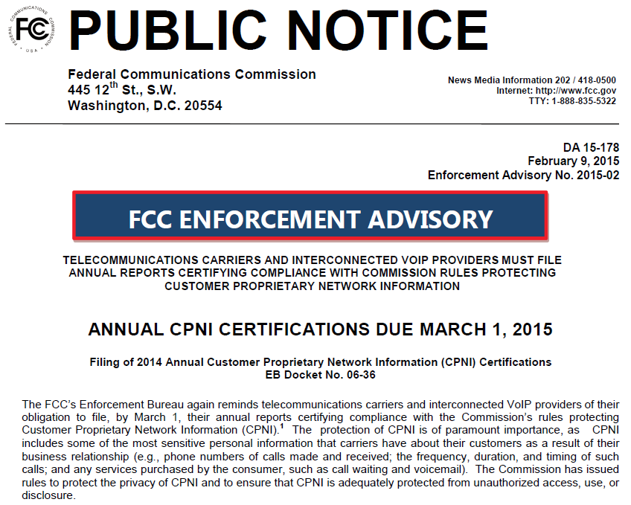

Does the fcc really care about cpni?
https://transition.fcc.gov/eb/Headlines.html
95 CPNI notices

Slide 7
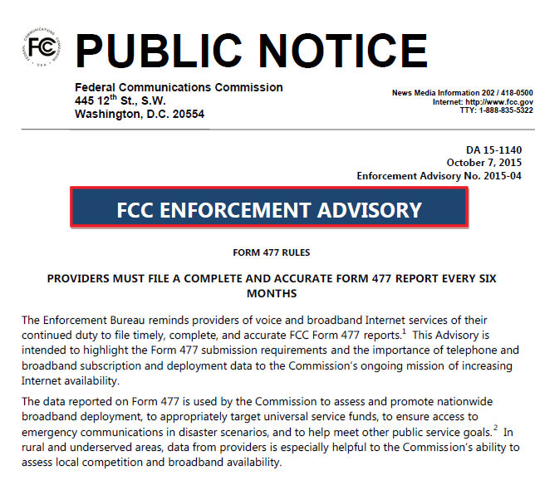
Does the FCC Really Care about the 477?

Slide 8
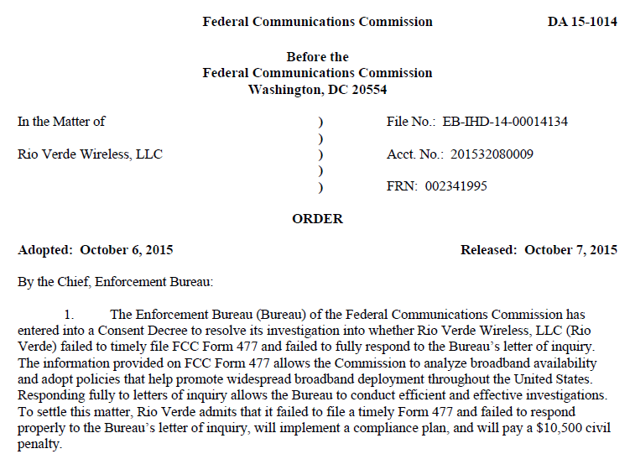
What Are They Gonna Do About It?

Slide 9
Questions?
Jonathan E. Allen
Rini O’Neil, PC
202.955.3933
jallen@telecommediatechlaw.com
Twitter: @JonathanEAllen
Kristopher E. Twomey
Law Office of Kristopher E. Twomey, P.C.
202.681.1850
kris@lokt.net

Slide 10
THANK YOU!

